Slide 1

ASSIGNMENT GUIDELINES
Make the changes in the PPT as you solve the parts
This file contains the template for all the parts of the project.
Check the instructions added in the note section of every slide for clarity.
Don’t move around any image or text box
If you require more/lesser elements, be careful when you copy/delete the existing ones.

Slide 2
ASSIGNMENT Name : Vishnu Teja Pakalapati
Problem Statement The sales pipeline conversion percentage at TechnoServe (a tech SaaS startup) has dropped from 35% at the end of last fiscal (FY 2017-18) to 25% at present.
Assignment Objective
Understand the problem, come up with a hypothesis for low conversions faced by TechnoServe, and analyse the dataset provided to arrive at possible solutions to increase it.
Notes:
Problem Statement

Slide 3
PART I : 1. Understanding the Problem Sales Pipeline Conversion at a SaaS Startup
Who ?
The Company is TechnoServe, Which is based in Pune and offers a variety of IT solutions spanning different industries and has clients not only from Pune but other cities as weller here
What ?
pipeline conversion for the profitable customers has been decreasing, which means the conversion rate of the Leads brought by the marketing and sales team has decreased from 35 percent to 25 percent
When ?
Since the last 3 quarters
Where ?
Happening around the Sales and Marketing team
How ?
Improper Budget Allocation and Cost Cutting, Product not up to current standards

Slide 4
PART I : 2. Understanding the Problem Sales Pipeline Conversion at a SaaS Startup
Situation
What are primary reasons for declination of Conversion rate
What are the immediate changes done in the organization to control the problem
What is the primary selling point in your product and is it still unique compared with your competitors
What changes needs to be done and in which department
Problem
Are the Marketing methods that are being used Effective
Is our Product up to the industry standards
Are the budget and resources being distributed effectively amongst all the teams
Is There any friction between the Marketing and product team that might affect the quality of the product
Implication
Does the revenue loss have an impact on the future Goals of the Company
Is the decrease in conversion rate impacting our market share
Will the existing customers return back to our product
Need-Payoff
If the problem is Solved will the extra Revenue help us allocate more budget to upgrade our product
Does it help us in increase our market share
Does it increase our brand value resulting in more leads
Does the solution make the employees more efficient
Notes:
Provide at least three questions under each branch.

Slide 5
PART II : Formulating Hypotheses Sales Pipeline Conversion at a SaaS Startup
Framework Used -
Used Issue True Framework.
Reason for using the selected framework -
In The given Problem I find Issue Tree is the most effective way to Find a solution , Because it helps us disintegrate the problem into multiple components and then drill down to multiple hypothesis at the end of each branch.
How you have used the framework here -
Techno serve, SaaS provider company is facing a relevant problem where the company is falling to convert its potential customers into clients and the conversion rate across its sales funnel is decreasing. As per the data where the company is having major problems in the marketing product issues and optimized planning the issue tree framework can help identify the potential root cases by categorizing, filtering the problems and along with specialized frameworks will help to solve the problem better, which helps in prioritizing the solutions better using MECE rule.
Notes:
All the frameworks that are used should be mentioned.
A suitable reason is a must to provide here

Slide 6
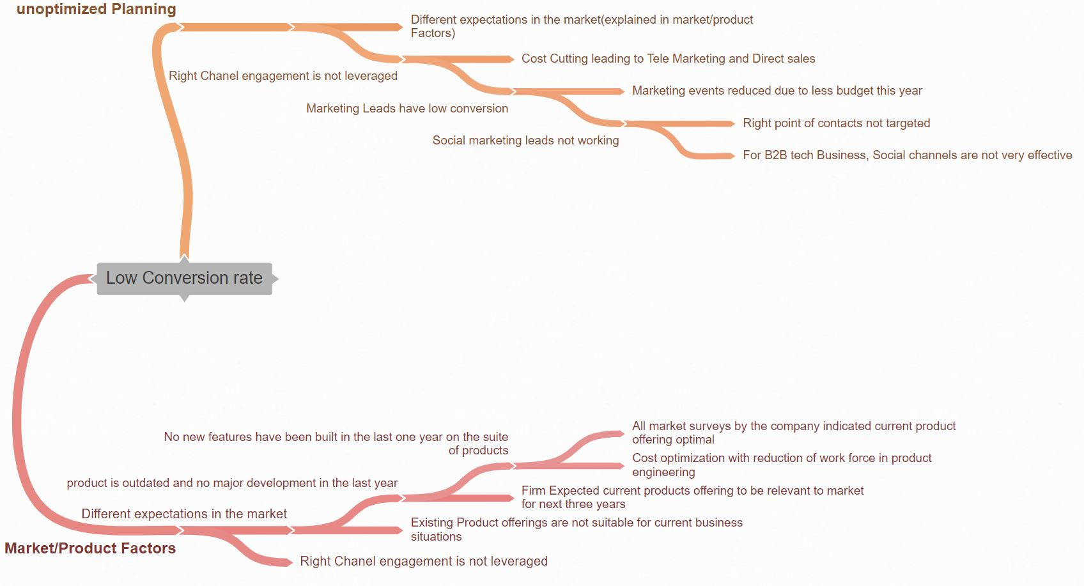
PART II : Formulating Hypotheses Sales Pipeline Conversion at a SaaS Startup
Provide the structure of the framework here
(You can attach the screenshot or multiple screenshots depending on the clarity of the image)
Notes:
Use the “download as” feature of Coggle if you are using the tool.
Provide one image with complete tree along with separate elements where the text is readable.
Copy the slide if you require more space

Slide 7
PART II : Formulating Hypotheses Sales Pipeline Conversion at a SaaS Startup
Branch 1
The Reason for low conversion rate have primarily branched out into two main reasons one being Unoptimized Planning, which further branches out into potential reasons which are improper Chanel engagement and not designing our products according to market expectations
Branch 2
The other branch being Market/Product factors it further branches out into potential reasons that helps us understand what might have went wrong within the Marketing and the product engineering team
Notes:
Each branch must follow this naming pattern: Problem – Branch 1 – Sub-branch 1 – Sub-branch 2 – …… – Hypotheses
There must be minimum 10 hypotheses in total and at least 1 in each branch.

Slide 8
PART II : Formulating Hypotheses Sales Pipeline Conversion at a SaaS Startup
Branch 3
Different expectations in the market - The Product that TechnoServe Produced Is not not on par with the current market expectation .
Branch 4
Right Chanel Engagement is not leveraged – The marketing team did not target the right channels to market , the primary reason for this is budget cuts
Notes:
Each branch must follow this naming pattern: Problem – Branch 1 – Sub-branch 1 – Sub-branch 2 – …… – Hypotheses
There must be minimum 10 hypotheses in total and at least 1 in each branch.

Slide 9
PART II : Formulating Hypotheses Sales Pipeline Conversion at a SaaS Startup
Branch 5
Social Marketing Leads not working - The marketing team chose to advertise their products on social Networking sited which is not very effective for B2B tech business, on the other hand marketing events have also been reduced due to budget cuts which might be more relevant to B2B customers
Branch 6
product is outdated and no major development in the last year – The reason the product is not updated is because the firm expected that showed that the current product is relevant to the market for the next 3 years
Notes:
Each branch must follow this naming pattern: Problem – Branch 1 – Sub-branch 1 – Sub-branch 2 – …… – Hypotheses
There must be minimum 10 hypotheses in total and at least 1 in each branch.

Slide 10
PART II : Formulating Hypotheses Sales Pipeline Conversion at a SaaS Startup
Branch 7
No New featured have been added to the product in the last year – The product and the engineering team have not added any new features to the program while the competitors products are making changes every year adding new features which might attract new potential clients
Branch 8
Cost optimization with reduction of work force in product engineering -Due to insufficient work force because of Cost optimization, with a small team it is impossible to provide support and add new features to the existing product
Notes:
Each branch must follow this naming pattern: Problem – Branch 1 – Sub-branch 1 – Sub-branch 2 – …… – Hypotheses
There must be minimum 10 hypotheses in total and at least 1 in each branch.

Slide 11
PART II : Formulating Hypotheses Sales Pipeline Conversion at a SaaS Startup
Branch 9
All market surveys by the company indicated current product offering optimal - The surveys conducted by the firm indicated that that the current product is optimal which is the reason they did not invest enough budget in product an engineering team resulting in creating a product that is not on par with the industry expectations
Notes:
Each branch must follow this naming pattern: Problem – Branch 1 – Sub-branch 1 – Sub-branch 2 – …… – Hypotheses
There must be minimum 10 hypotheses in total and at least 1 in each branch.

Slide 12
PART III A : Generating Insights Sales Pipeline Conversion at a SaaS Startup
Variable
- Based on City
Based on Product
Based on Clients Revenue
Sales Medium
Business from clients Last Year
Insights
- Mumbai and Kolkata's Conversion rate’s are higher compared to other states
- The Conversion rates of Analytics Products are High and Legacy modernization are low
- Clients with more than 1 M revenue showed low conversion rates
- Enterprise Sellers are having the highest Conversion rate, while Online leads had a very poor conversion rate
- 83% of our recurring clients from last year did a business less than 25000
Pattern of Insight
- Clients from Mumbai are more likely to convert
- Focus more on marketing Analytics Products
-Focus on clients with revenue from 100k to under 1 M
- Do not Advertise on Online Platforms
- Try to get New Clients
Notes:
Analyse the variables in the dataset, find the insights and mention the pattern of insights in the data. Make more copies of this slide if needed.

Slide 13
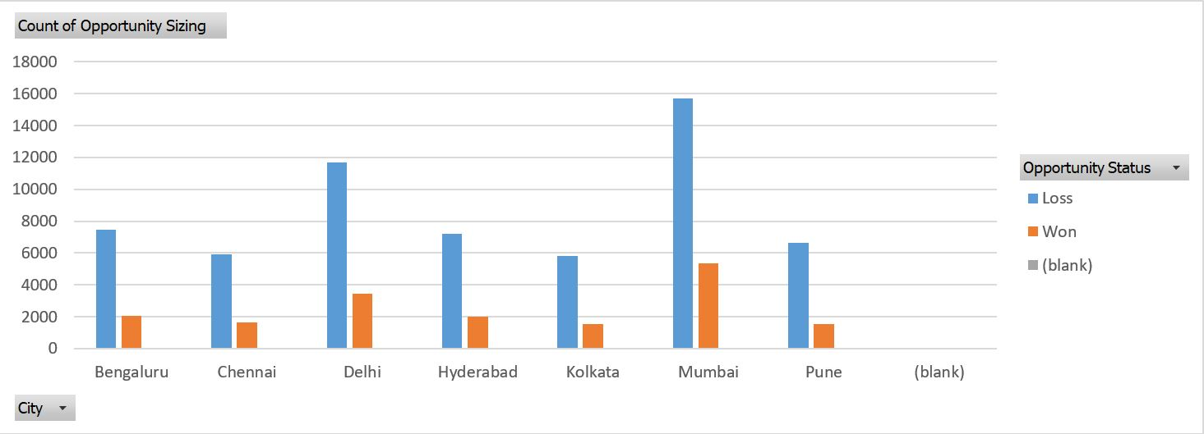
PART III A : Generating Insights Sales Pipeline Conversion at a SaaS Startup
Variable under consideration: CITY
Mumbai had the highest Conversion rate with 25% being converted , while all the other states had decent conversion rated around 23-21%, but Pune had the lowest Conversion rate with just 19%, the marketing team should focus on targeting Mumbai and avoid Pune
Notes:
For each variable that produced an interesting insight, explain you analysis bit here – the results you got from excel and the necessary visualisations. Note: it is compulsory for you to mention the results of the analysis on these variables - 'Technology Primary', 'B2B Sales Medium', 'Client Revenue Sizing', 'Opportunity Sizing' and 'Business from Client last year’.

Slide 14
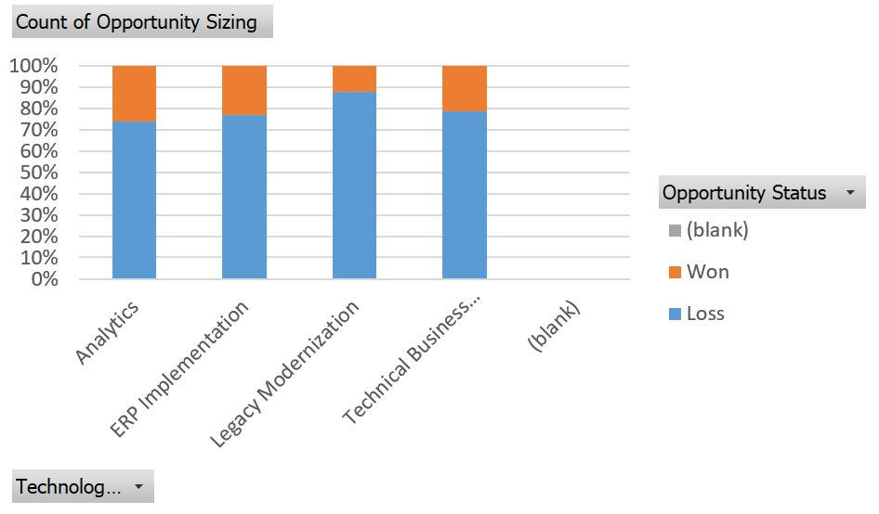
PART III A : Generating Insights Sales Pipeline Conversion at a SaaS Startup
Variable under consideration: Product
Analytics had the Highest Conversion rate with 26% percent being converted , while ERP implementation had 23% and Technical business solutions had 21 percent , Legacy Modernization had a very poor conversion rate of just 12%, we need to target clients who are willing to but analytics products or Invest time and money to improve Legacy Modernization
Notes:
For each variable that produced an interesting insight, explain you analysis bit here – the results you got from excel and the necessary visualisations. Note: it is compulsory for you to mention the results of the analysis on these variables - 'Technology Primary', 'B2B Sales Medium', 'Client Revenue Sizing', 'Opportunity Sizing' and 'Business from Client last year’.

Slide 15
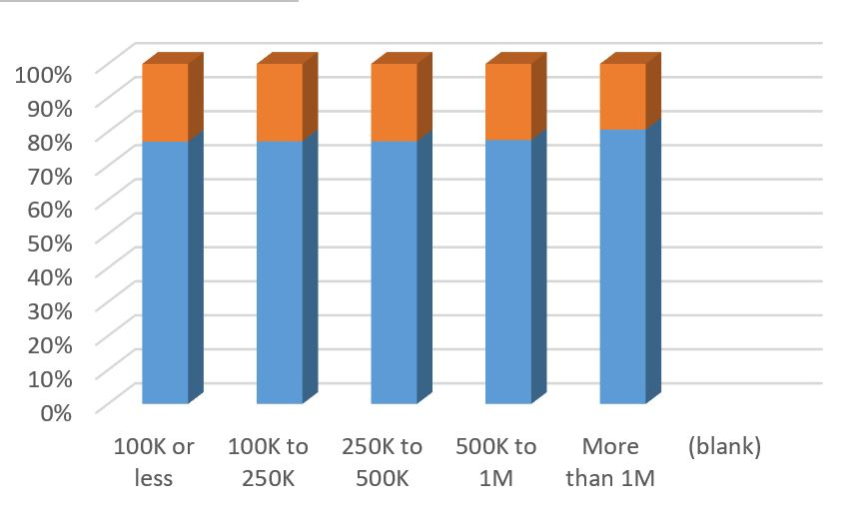
PART III A : Generating Insights Sales Pipeline Conversion at a SaaS Startup
Variable under consideration: Based on clients revenue
Clients with revenue less than 1 M had a good and similar conversion rate of 23-22 %, while Clients more than 1 M in revenue had a very poor conversion rate of just 19%, in the future marketing campaigns focus more on clients with less than 1 M in revenue
Notes:
For each variable that produced an interesting insight, explain you analysis bit here – the results you got from excel and the necessary visualisations. Note: it is compulsory for you to mention the results of the analysis on these variables - 'Technology Primary', 'B2B Sales Medium', 'Client Revenue Sizing', 'Opportunity Sizing' and 'Business from Client last year’.

Slide 16
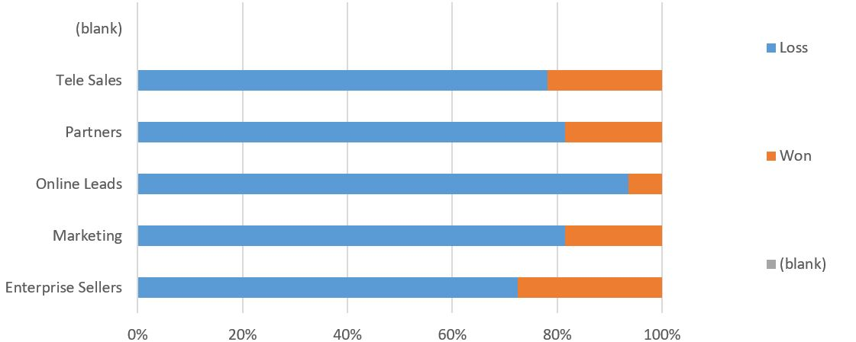
PART III A : Generating Insights Sales Pipeline Conversion at a SaaS Startup
Variable under consideration: Sales Medium
Enterprise Sellers are having the highest conversion rate with 28% being converted, while Online leads are the least with just 6%, the online , we should focus more on Enterprise and Tele Sales and avoid Online Marketing
Notes:
For each variable that produced an interesting insight, explain you analysis bit here – the results you got from excel and the necessary visualisations. Note: it is compulsory for you to mention the results of the analysis on these variables - 'Technology Primary', 'B2B Sales Medium', 'Client Revenue Sizing', 'Opportunity Sizing' and 'Business from Client last year’.

Slide 17
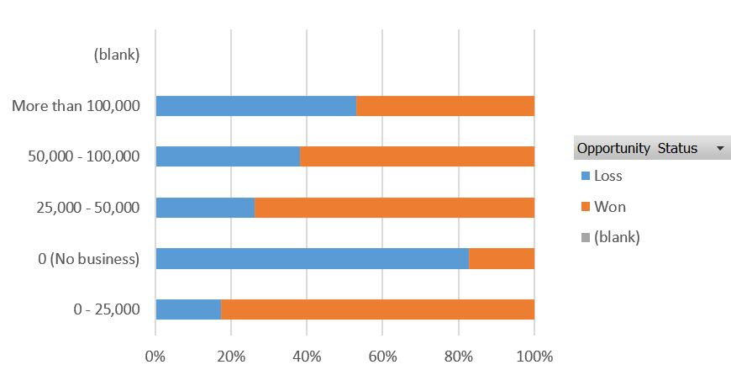
PART III A : Generating Insights Sales Pipeline Conversion at a SaaS Startup
Variable under consideration: Business from client last year
Clients who did business less than 25000 last conversion rate of 83%, while people who have not done business has the conversion rate of just 19%
Notes:
For each variable that produced an interesting insight, explain you analysis bit here – the results you got from excel and the necessary visualisations. Note: it is compulsory for you to mention the results of the analysis on these variables - 'Technology Primary', 'B2B Sales Medium', 'Client Revenue Sizing', 'Opportunity Sizing' and 'Business from Client last year’. Make more copies of this slide if needed.

Slide 18
PART III A : Generating Insights Sales Pipeline Conversion at a SaaS Startup
Recommendations
Do not Market on Online Medium, because tech sales tend to have low conversion rates using online medium
Try to improve products such as legacy modernization
Market more in cities like Mumbai and Delhi, with higher conversion rates
Focus on recurring clients they tend to have high conversion rate
Focus more on clients with less than 100k in revenue, even though the generate less revenue they have high conversion rate and are more in quantity
Corresponding Insights
Cities such as Mumbai and Delhi have high conversion ratees
Analytics and
Notes:
For each recommendation explain the insights that form the reasoning for giving that recommendation. Make more copies of this slide if necessary.

Slide 19
PART III B : Presenting Findings Sales Pipeline Conversion at a SaaS Startup
Notes:
You are free to use the elements and boxes mentioned previously. Make sure you’re using the pyramid principle, data visualization, visual design principle and storyboarding concepts to design these slides.

Slide 20
PART III B : Presenting Findings Sales Pipeline Conversion at a SaaS Startup
Notes:
You are free to use the elements and boxes mentioned previously. Make sure you’re using the pyramid principle, data visualization, visual design principle and storyboarding concepts to design these slides.

Slide 21
PART III B : Presenting Findings Sales Pipeline Conversion at a SaaS Startup
Notes:
You are free to use the elements and boxes mentioned previously. Make sure you’re using the pyramid principle, data visualization, visual design principle and storyboarding concepts to design these slides.

